Slide 1
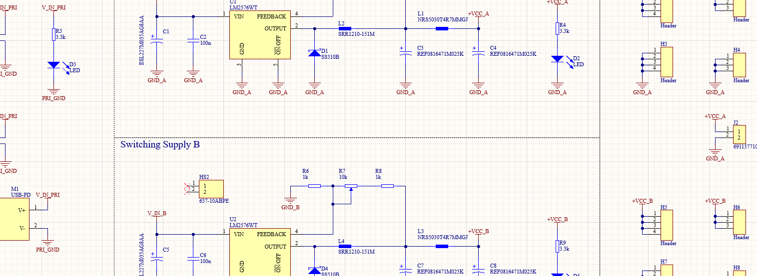

IEEE PCB Design Workshop: (Week 02) Datasheets and Components
<N
Hosted By: Adrian Sucahyo and IEEE at the University of Utah
Adapted From: IEEE x FSAE Workshop SP25 with Nick Howard and Adrian Sucahyo

Slide 2

Workshop Outline
Schedule:
Feb. 17 – Introduction to Schematics
Feb. 10 – Datasheets and Components
Mar. 3 – Introduction to PCB Layout
** SPRING BREAK **
Mar. 17 – Layout Continued
Mar. 24 – Soldering Week 1
Mar. 31 – Soldering Week 2
Apr. 3 – Soldering Week 3

Slide 3
Announcements
Alternative Projects
We will be able to get alternative project boards manufactured if submitted by the deadline.
Limited to the 10 cm x 10 cm dimensions outlined by JLCPCB.
Talk or email me if you have any questions!

Slide 4
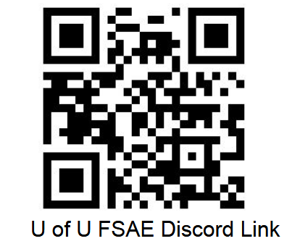
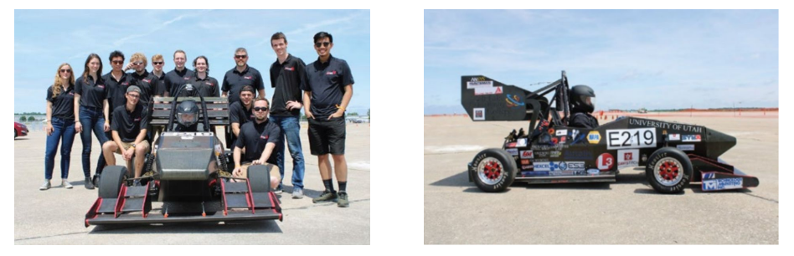
Want more experience?
Consider joining the FSAE tractive team!
The Tractive Team is currently looking for students to assist with designing and assembling the electrical system for an electric formula-style race car!
No experience required!

Slide 5


Join the IEEE Discord
If you haven’t already, please join the IEEE Discord server for additional information and updates regarding this workshop

Slide 6
Component Selection
Component selection poses a challenge during the design stage.
Selection should be driven by design constraints.
Cost
Size
Performance

Slide 7


Component Search
Manufactures and Distributors may provide component search functions
Manufacture Search:
Specific Functionality, Performance
More details on specifics
Narrower Scope
Distributor Search:
Wider Component Reach
Multiple Manufacturers
Broader Search Parameter

Slide 8
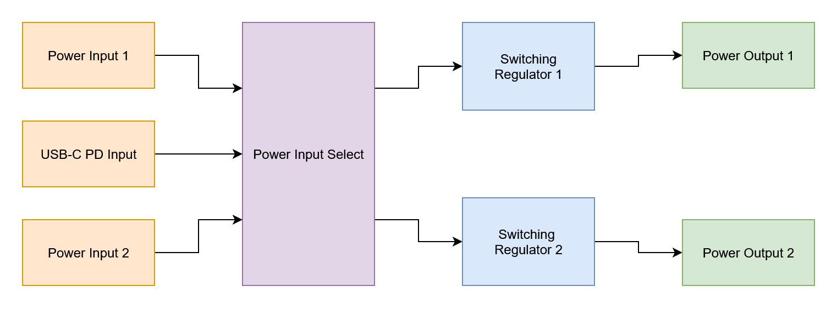
Block Diagram
Block diagram drawn using draw.io

Slide 9
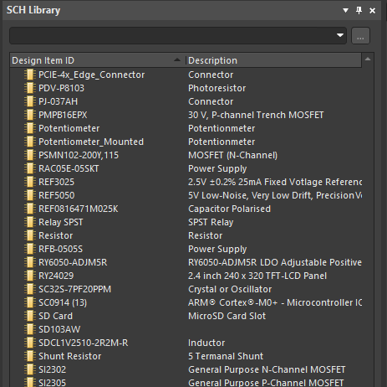
Component Libraries
Libraries are collections of components and footprints
All components for a project must be derived from a library
Projects may reference multiple different component libraries
Relatively consistent across platforms
Typically, there are symbol and footprint libraries
Tightly coupled together

Slide 10
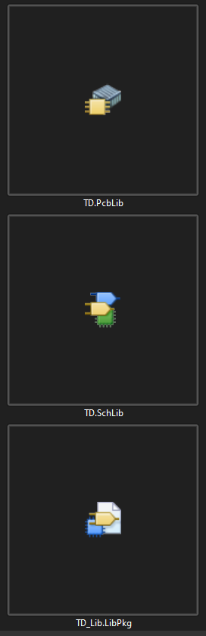
Component Library Types (Altium)
.SchLib
Contains all component schematic symbols
.PcbLib
Contains all footprint information
.LibPkg
Also known as an integrated library
Packages multiple .SchLib and .PcbLib libraries together for easier management

Slide 11


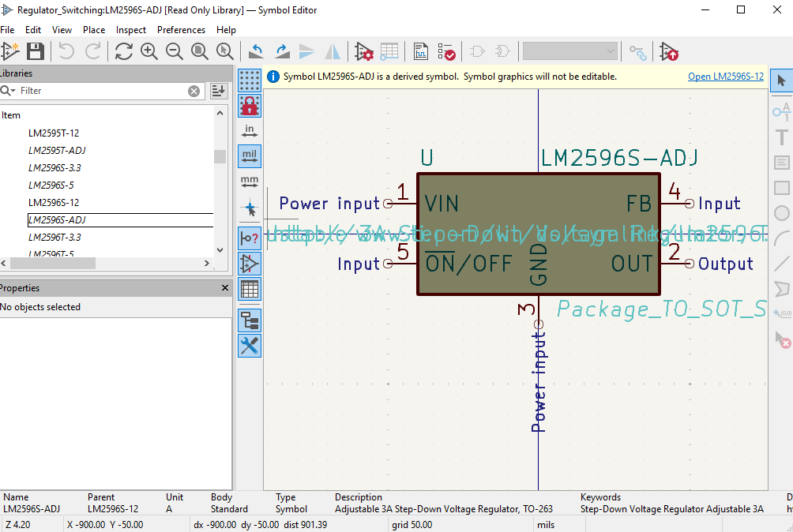
Component Library Types (KiCAD)
.kicad_sym
Contains all the symbol information for components in the library
.pretty
Contains all the footprint information to be used with components

Slide 12
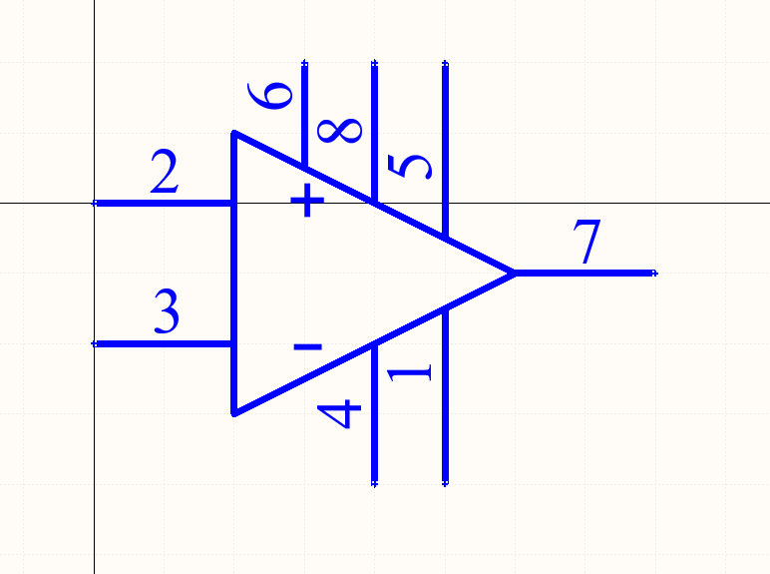
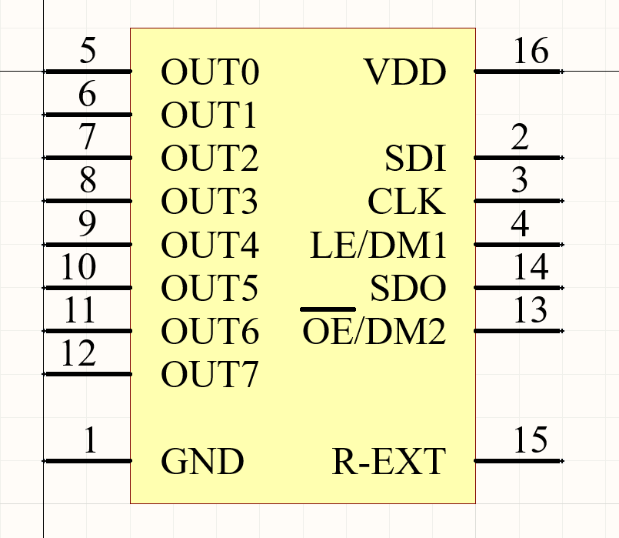
Making Component Symbols
Making symbols is a time-consuming process
All pins and designators must be correct, or they will result in errors during layout
Requires the ability to read a datasheet

Slide 13
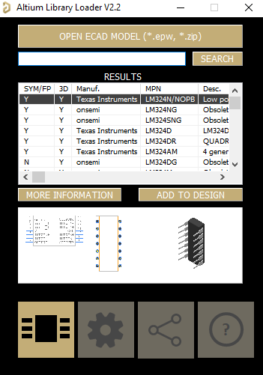

SamacSys (Component Manager)
SamacSys is a third-party component manager
Integrates with Altium with an extension
Creates schematic symbols and footprints for you
Can be used with KiCAD as well

Slide 14
Questions?
Questions?

Slide 15
Download Today’s Project Files
Navigate to the workshop GitHub and download today’s files https://github.com/IEEE-U-of-U/IEEE-PCB-Workshop-Spring-2026

